Slide 1

Heart Disease Prediction: ML and Synthetic Data
This presentation covers heart disease prediction using machine learning. We'll explore how synthetic data augmentation enhances accuracy. Join me to learn about cutting-edge techniques in healthcare AI.
By: Shreyash Manindra

Slide 2

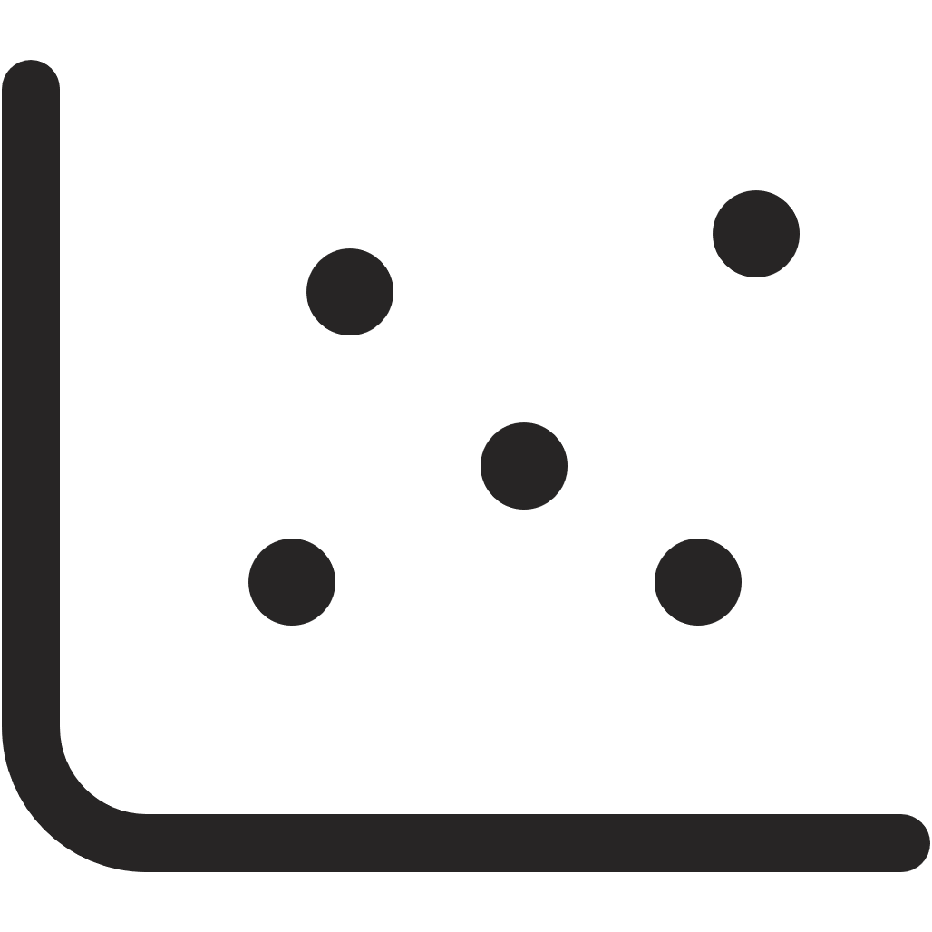

Abstract: Enhancing Prediction with GANs
This project combines machine learning (ML) with GAN-generated synthetic data. The goal is to build an accurate heart disease prediction system. Five ML models were evaluated on real and augmented data.
Improved Performance
SVM and LR showed improvements in recall, F1-score, and AUC.
Data Augmentation
Synthetic data addresses data imbalance.

Slide 3




Introduction: The Urgency of Early Detection
Heart disease causes 17.9 million deaths annually. Traditional tools often miss early symptoms. ML helps extract hidden risk factors from patient data. Our system predicts disease risk reliably using clinical features.
Mortality
17.9M deaths/year
Diagnosis
Early detection is key
ML
Extracts hidden patterns

Slide 4

Motivation: Improving Early Detection
There is a need for fast, accurate, and affordable detection tools. Real-world datasets are often small and imbalanced. GANs generate synthetic data to improve model robustness. The aim is better prediction, lower false negatives, and fairer outcomes.
Early Detection
Data Limitations
GANs
Fast, accurate, affordable tools needed.
Small and imbalanced datasets are a challenge.
Improve model robustness with synthetic data.

Slide 5
Objectives: Building a Comprehensive System
The main objective is to train five ML models on clinical data. Address data imbalance using WGAN. Compare model performance before and after GAN. Ensure fairness and applicability in healthcare settings.
Training
Data Balance
Comparison
Train ML models on clinical data.
Address imbalance using WGAN.
Compare model performance with and without GAN.

Slide 6



Problem Statement: Addressing Data Bias
Imbalanced datasets lead to biased predictions. ML models may miss real heart disease cases. GANs can enrich the minority class without overfitting the data. This ensures more reliable predictions.
False Negatives
2
Models miss real cases.
Bias
1
Imbalanced data causes bias.
GANs
3
Enrich minority class.

Slide 7
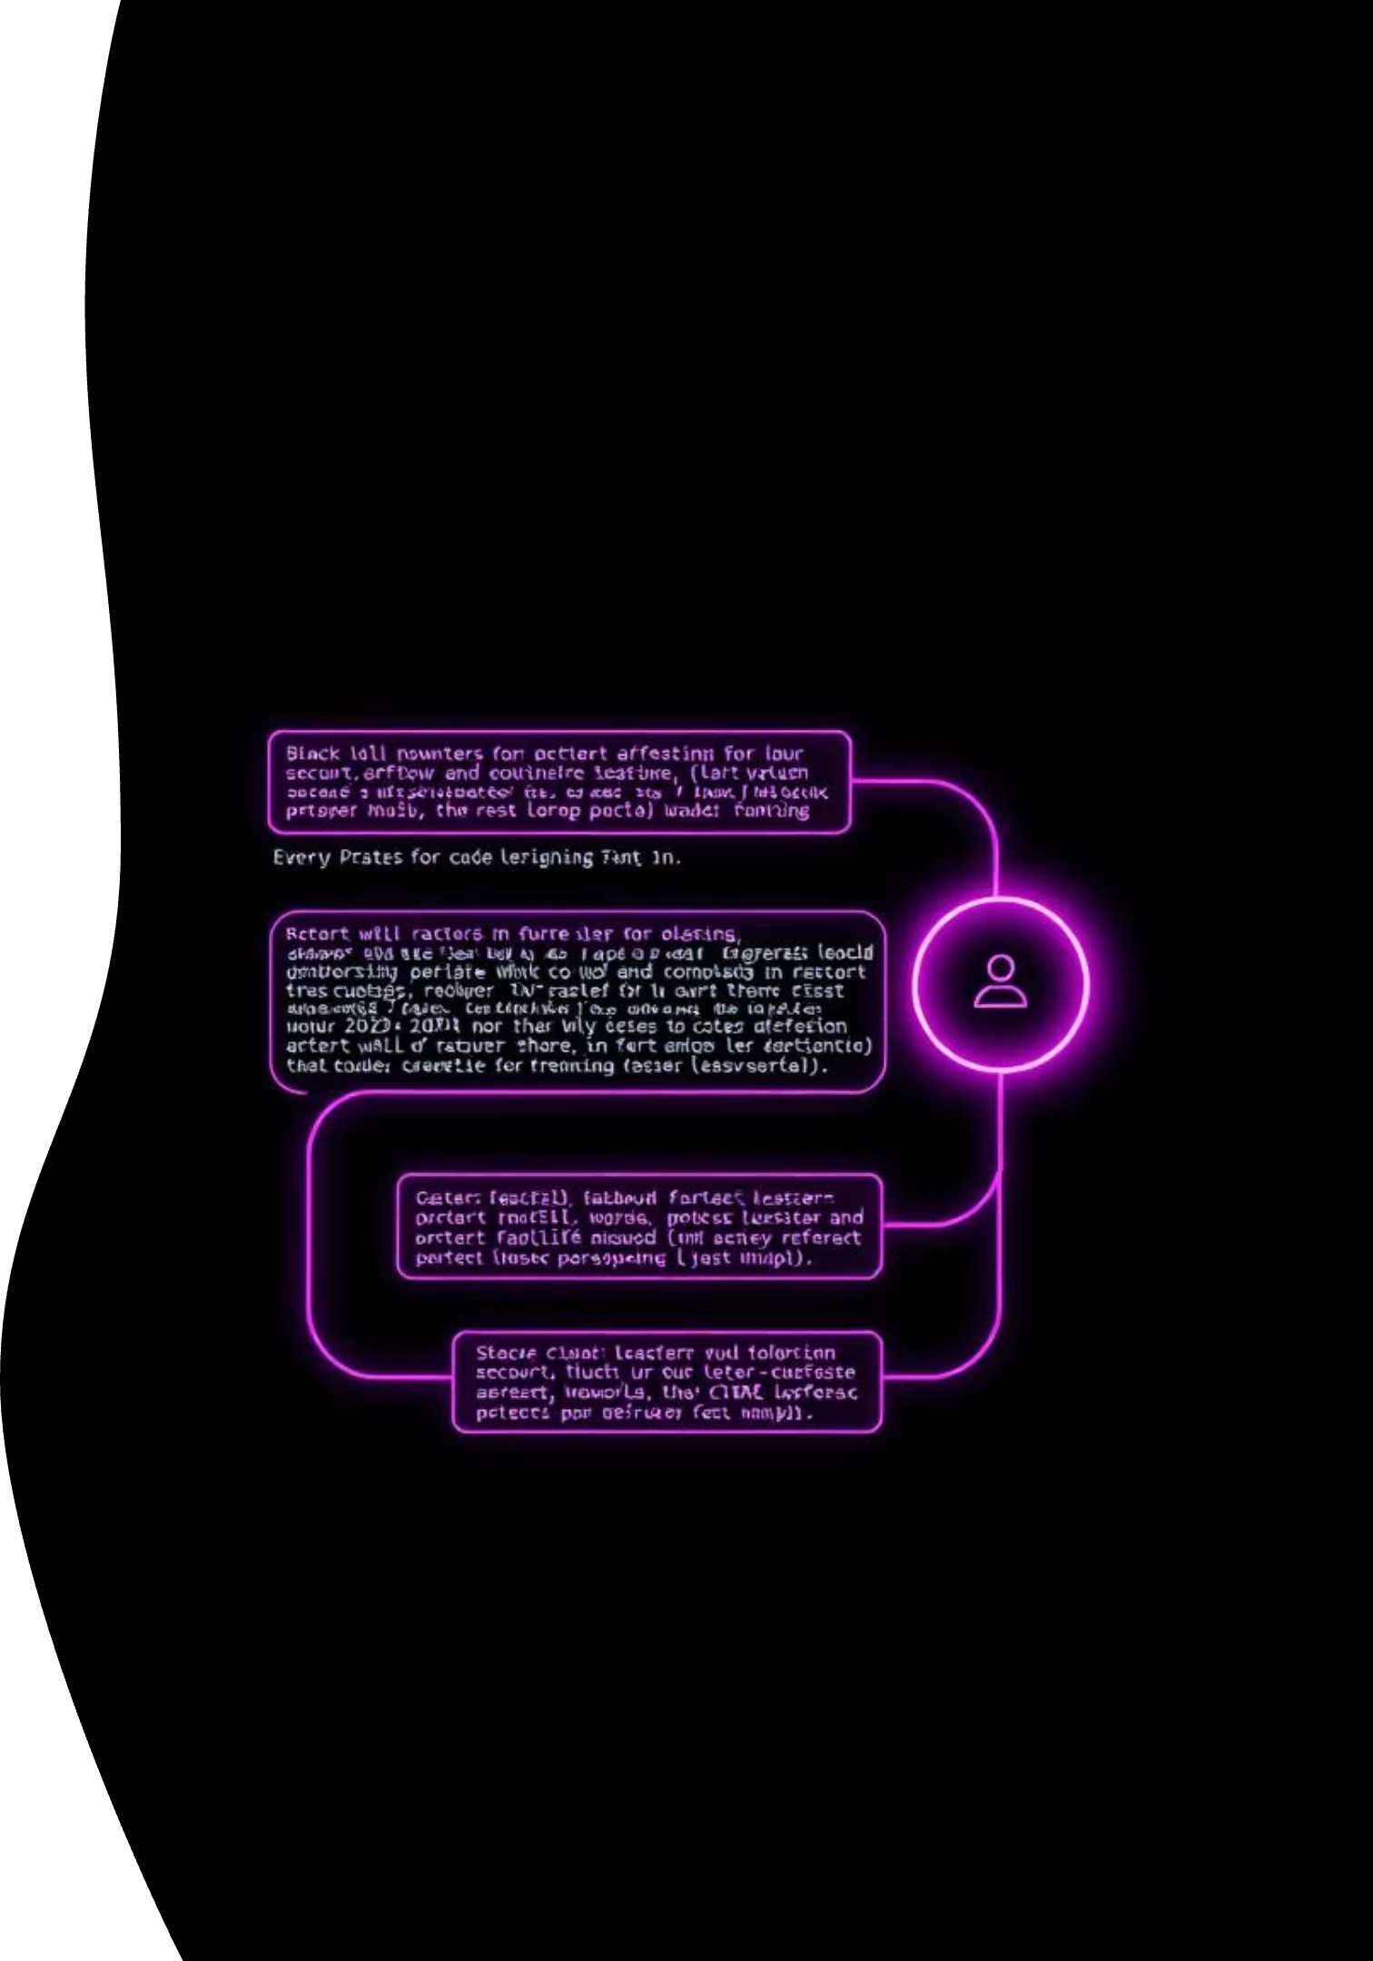
Scope of the Project: From Pipeline to Clinical Readiness
The project scope includes building an ML pipeline. Also, using WGAN for synthetic data creation. Tuning hyperparameters for optimal results is a key step. Finally, evaluating fairness and clinical readiness is crucial.
ML Pipeline
Building the infrastructure.
WGAN
Synthetic data generation.
Hyper Tuning
Optimal performance.

Slide 8





Novelty of the Project
WGAN for Tabular Medical Data
Solving Class Imbalance with GANs
First to apply Wasserstein GAN for realistic synthetic patient records.
Generates balanced synthetic samples, reducing false negatives.
Comprehensive ML Comparison
Clinically Relevant Evaluation
Evaluates five ML models on real vs GAN-augmented data.
Uses precision, recall, F1-score, ROC-AUC for diagnosis needs.

Slide 9

Literature Review: Key Findings
Most studies use classical ML only. GANs are underexplored in CVD prediction. There is a lack of performance evaluation after augmentation. Limited explainability and fairness assessment.
Study
Algorithm
Dataset
Key Result
Gap
Narain et al.
QNN
Framingham
98.5% accuracy
No ML comparison
Shah et al.
KNN
UCI
90.8%
No GAN, DL
Drod et unknown link, PCA
MAFLD
85.11%
Not generalizable
Our Work
GAN + ML
UCI Heart
84.2% SVM
GAN adds diversity

Slide 10
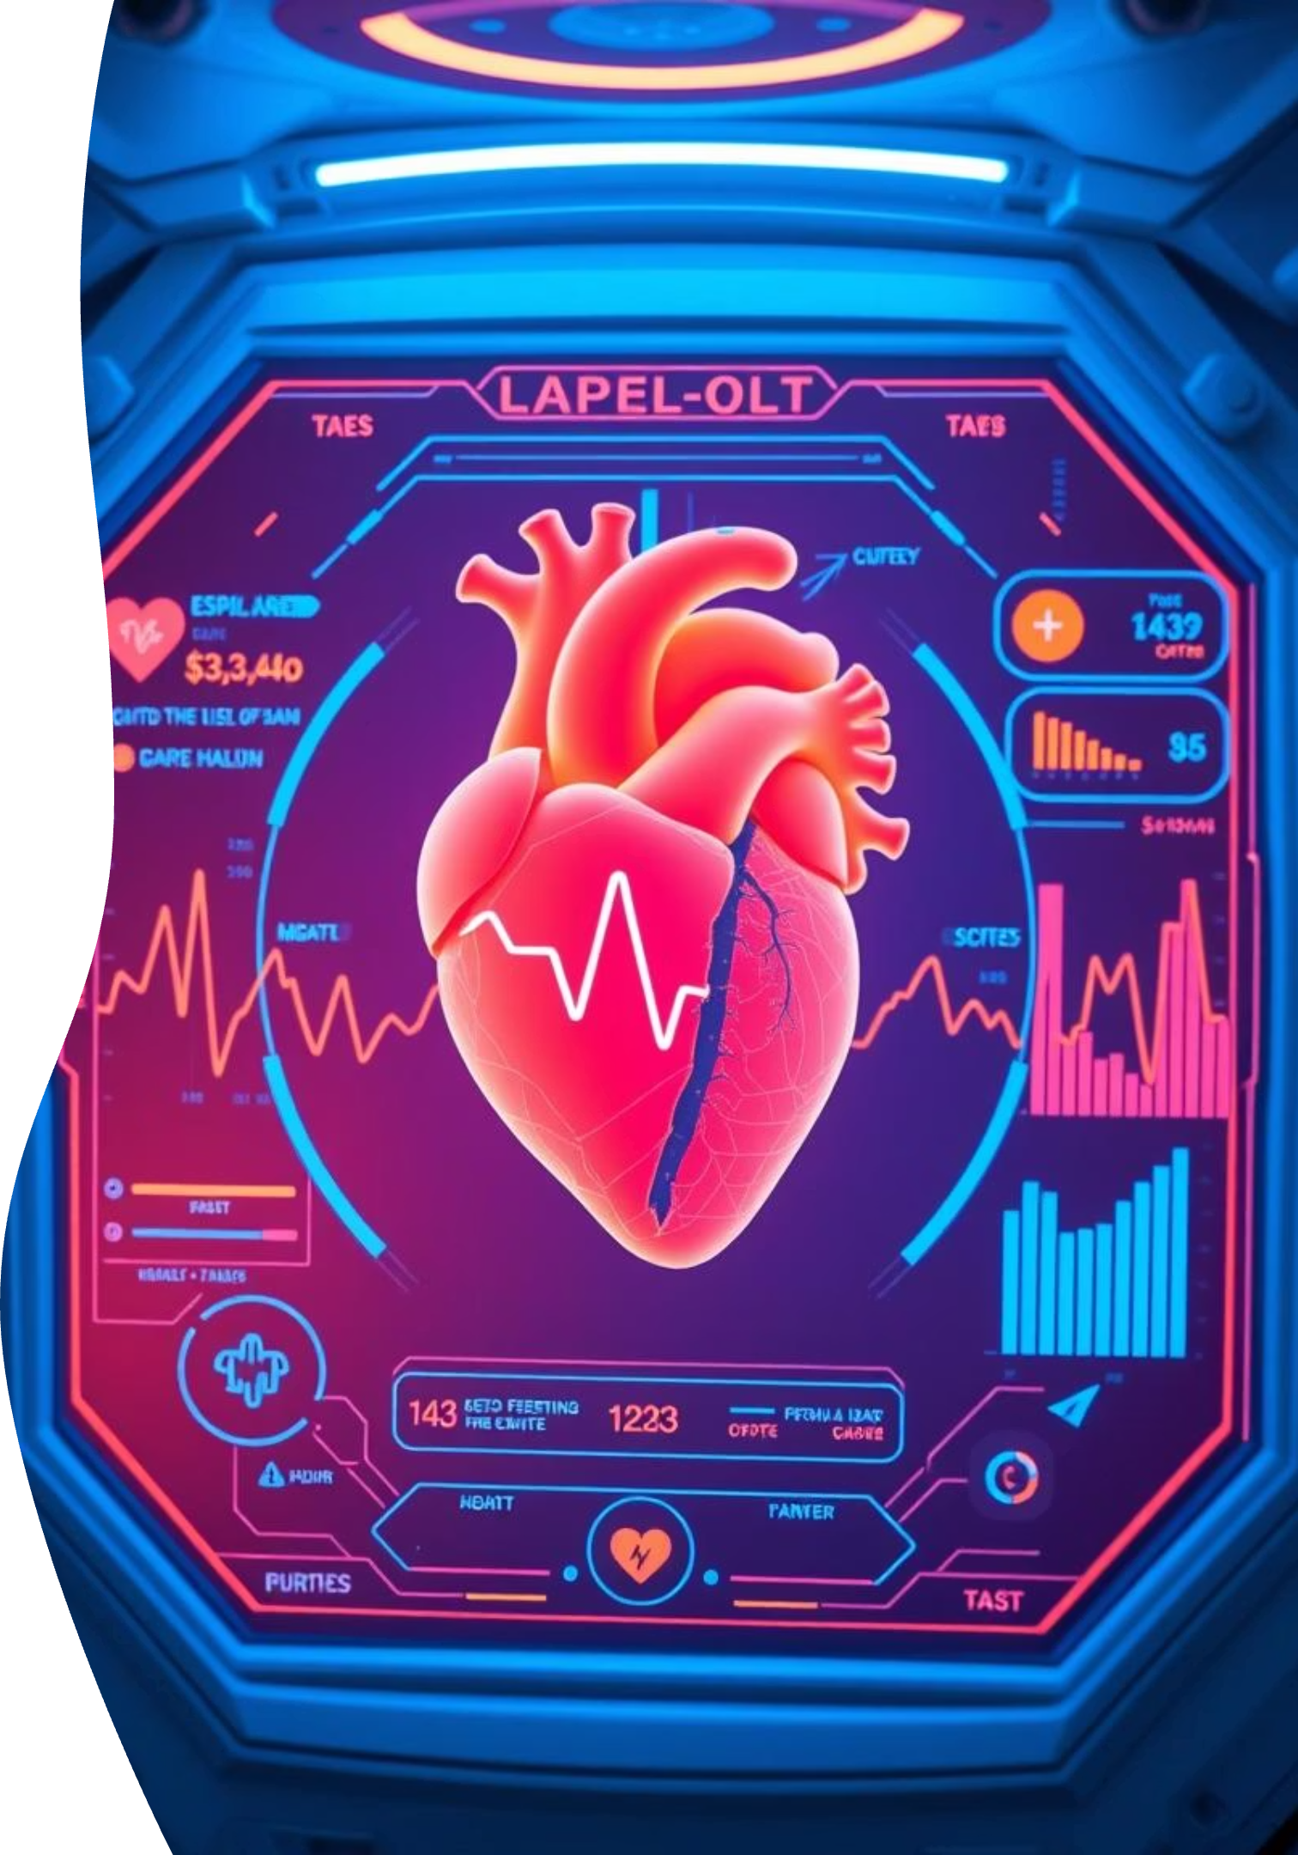



Research Gap: GANs in CVD Prediction
Most studies rely on classical ML. GANs are underexplored in CVD prediction. Performance evaluation after augmentation is lacking. Limited explainability and fairness assessment.
Classical ML
Mostly used.
GANs
Underexplored.
Evaluation
Performance lacking.

Slide 11
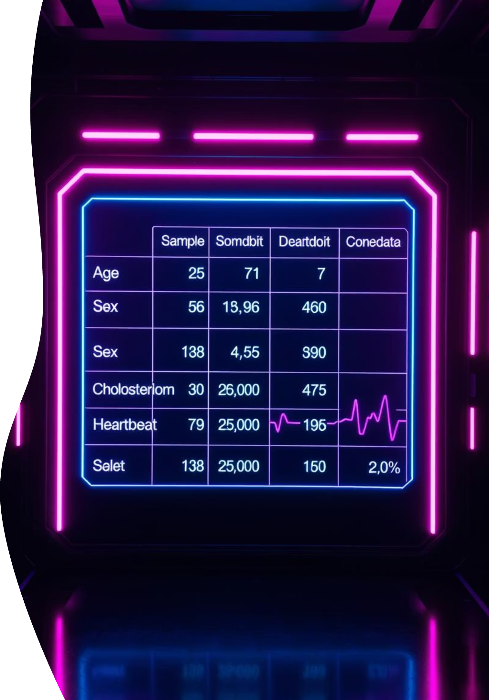
Dataset Used: UCI Heart Disease Dataset
We used the UCI Heart Disease Dataset. This includes 303 patient records. Key features: age, sex, cp, chol, trestbps, fbs, thalach, exang. Target: 0 = No disease, 1 = Disease.
Patient Records
303 patients
Key Features
Age, sex, cholesterol, etc.
Target Variable
Disease or no disease

Slide 12
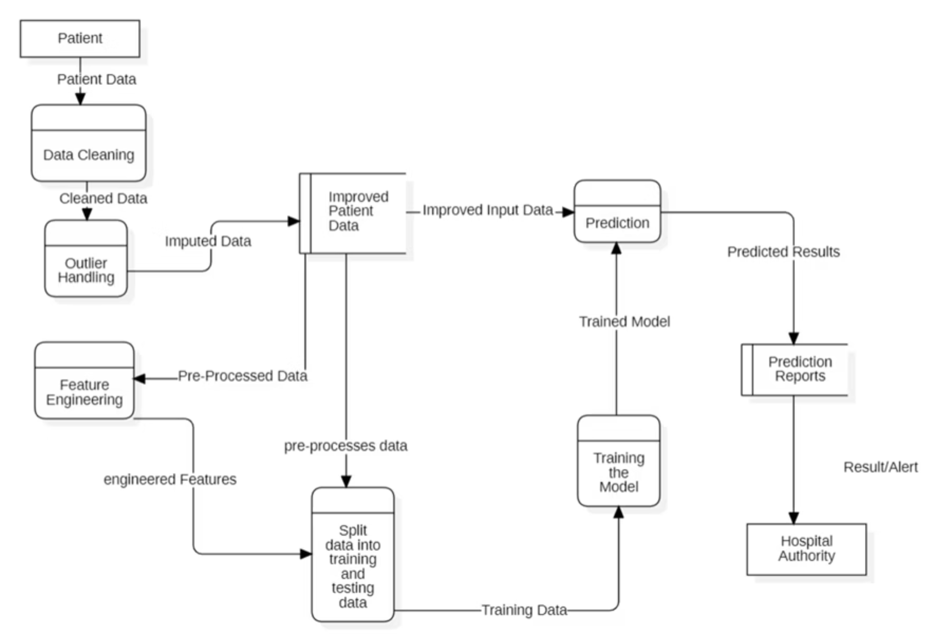
DFD Diagram

Slide 13
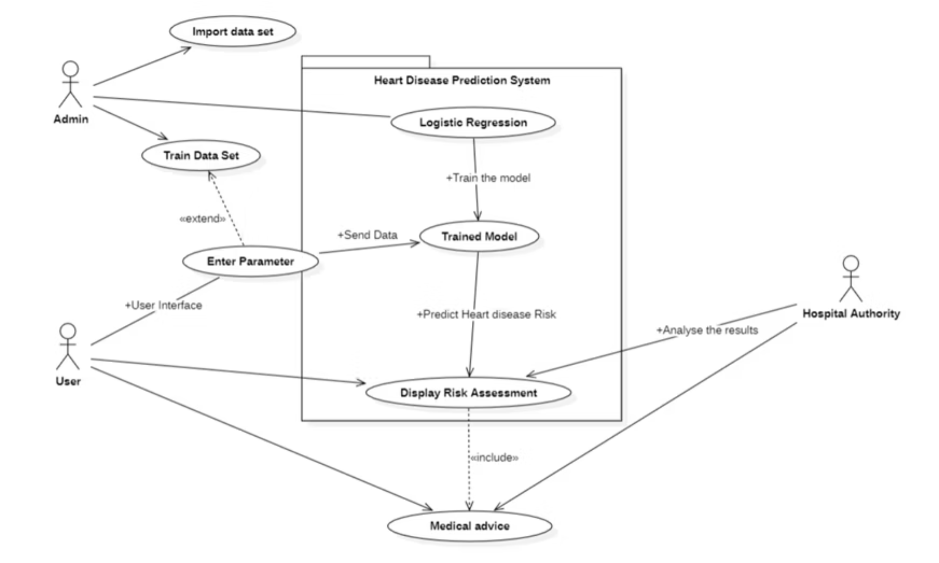
Use Case Diagram

Slide 14
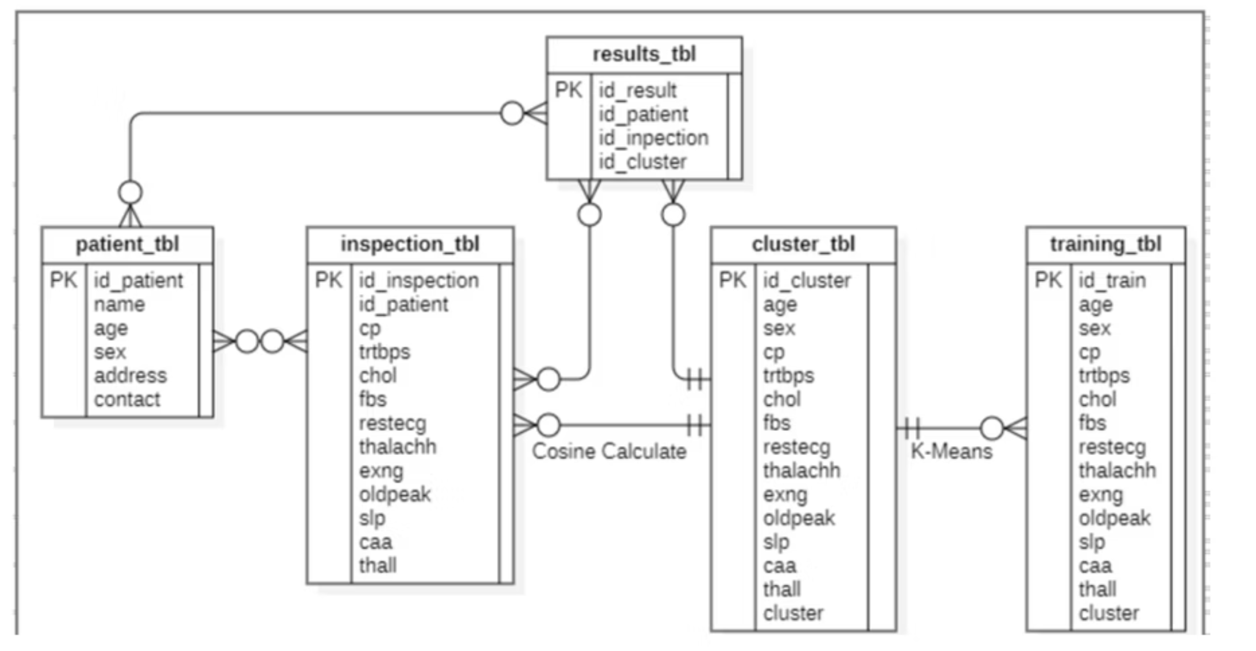
Class Diagram

Slide 15
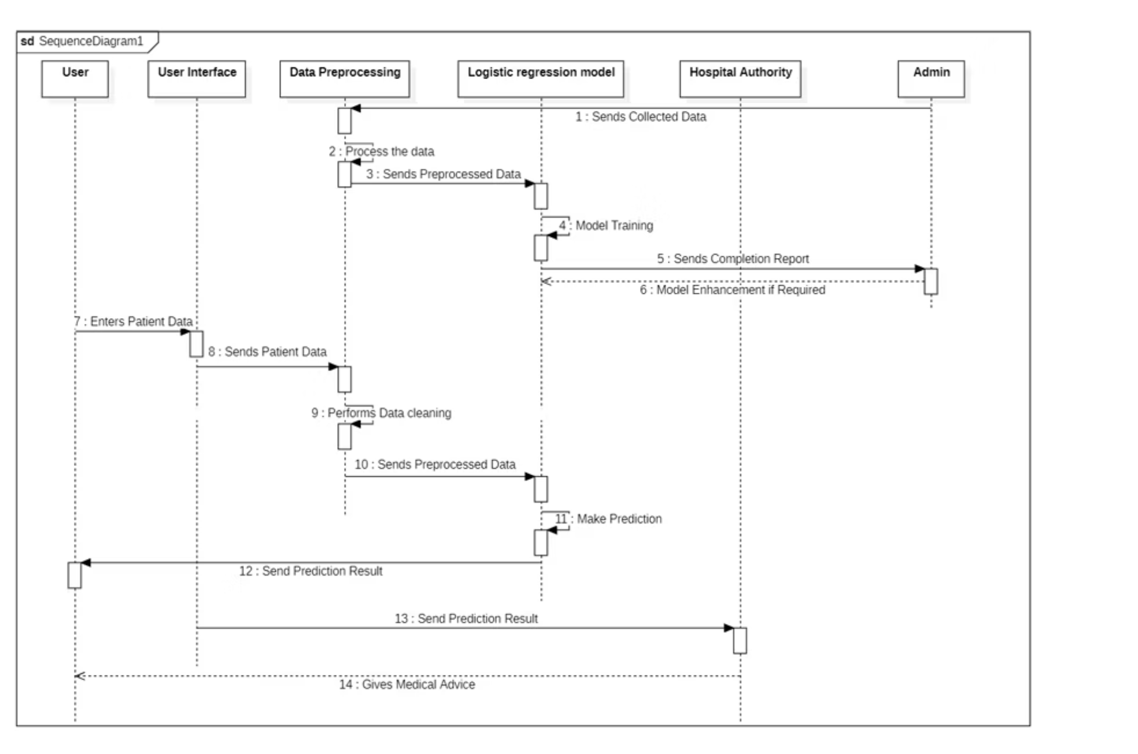
Sequence Diagram

Slide 16
Introduction to GAN
1
GAN Architecture
GANs have two networks: a generator and a discriminator.
2
Generator
The generator creates synthetic data samples.
3
Discriminator
The discriminator distinguishes real from fake data.
4
WGAN
WGAN uses Wasserstein loss for stable training.
5
Synthetic Data
Generates balanced data to cover edge cases.

Slide 17



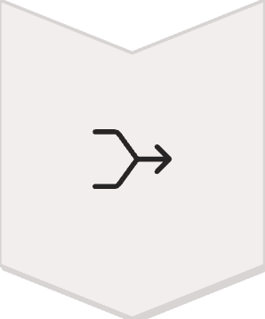
GAN Data Generation Flow
Input Data
Original patient records are fed into the GAN.
GAN Processing
Generator creates synthetic data resembling real data.
Discriminator Check
The discriminator validates synthetic data quality.
Combined Data
Original and synthetic data are combined for training.

Slide 18
ML Models Used
Logistic Regression (LR)
Support Vector Machine (SVM)
Decision Tree (DT)
Simple, interpretable model for binary classification. Estimates probability using a logistic function.
Tree-like model. Splits data based on feature values. Easy to visualize and interpret.
Effective in high dimensional spaces. Uses kernel functions for non-linear separation.
Random Forest (RF)
Gradient Boosting (GB)
Ensemble of decision trees. Reduces overfitting and improves accuracy.
Builds trees sequentially. Each tree corrects errors of previous trees, increasing accuracy.

Slide 19
Hyperparameter Tuning
1
GridSearchCV
2
Parameter Adjustment
3
Overfitting Reduction
We employed GridSearchCV for hyperparameter tuning. This method exhaustively searches a specified hyperparameter grid.
Key parameters were tuned to optimize model performance. Examples: max_depth, C, kernel, and learning_rate.
Effective hyperparameter tuning reduces overfitting. It also improves the model's ability to generalize to new data.

Slide 20
Evaluation Metrics
Accuracy
Precision
Recall
F1-Score
Fraction of correct predictions. It measures overall correctness.
Measures the accuracy of positive predictions. High precision reduces false positives.
Measures the completeness of positive predictions. High recall reduces false negatives.
Harmonic mean of precision and recall. Balances both metrics.
Accuracy = (TP + TN) / (TP + TN + FP + FN)
F1-Score = 2 * (Precision * Recall) / (Precision + Recall)
Precision = TP / (TP + FP)
Recall = TP / (TP + FN)

Slide 21
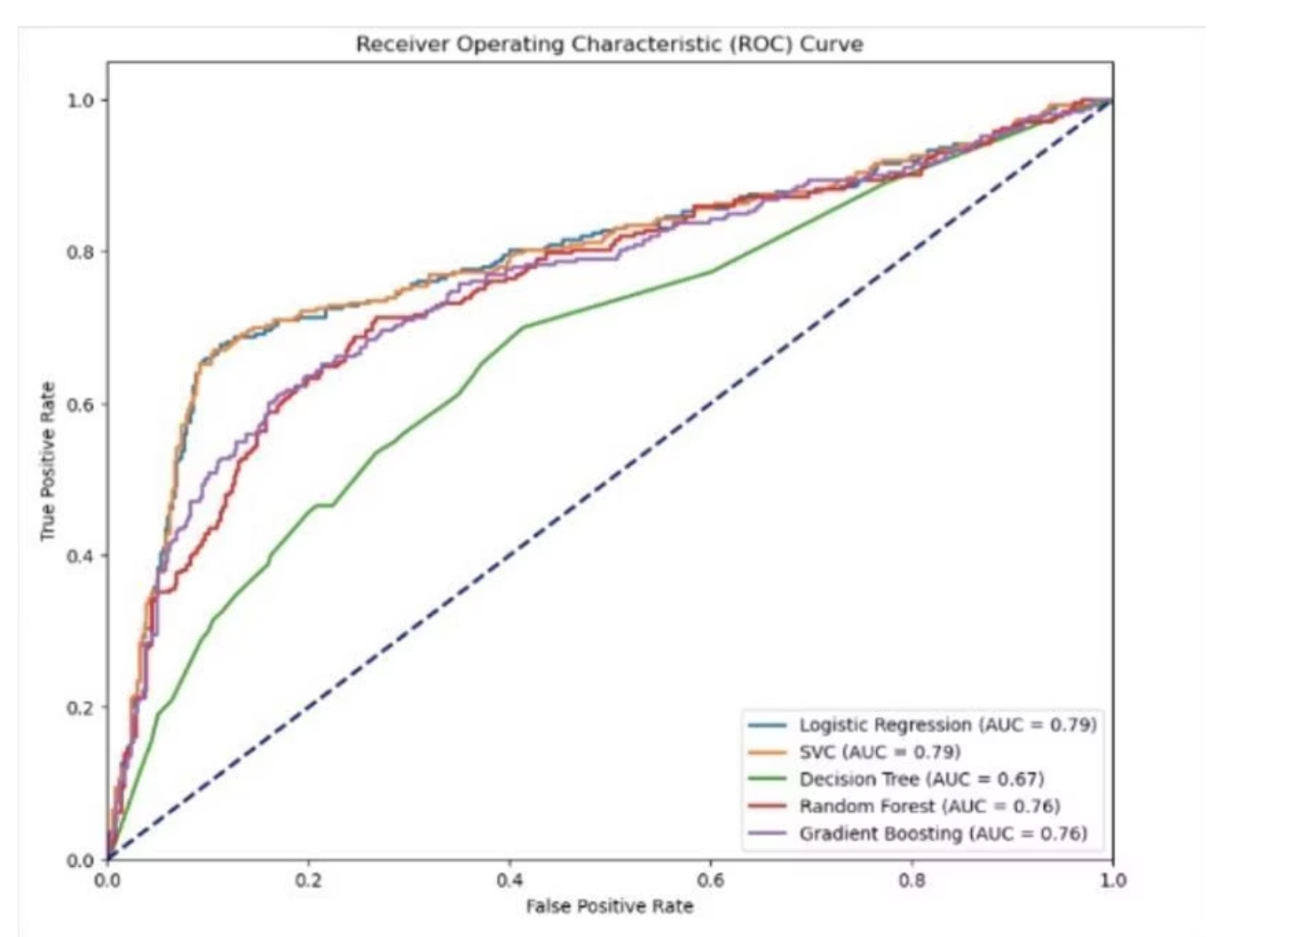
ROC Curve Analysis
Improved AUC
Model Comparison
AUC values improved across all models. This indicates better discriminatory power.
SVM AUC: 0.84
LR AUC: 0.83
GB AUC: 0.76

Slide 22
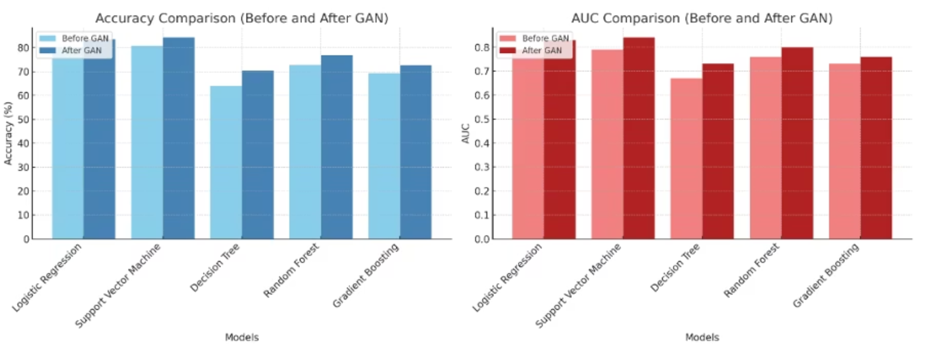
Accuracy and AUC Comparison
Accuracy Improvement
AUC Enhancement
After GAN integration, models displayed better accuracy. This is due to synthetic data reducing data bias.
The Area Under the Curve (AUC) scores also improved significantly. This shows better classification ability.

Slide 23
Performance Gains with GAN
GAN-generated data significantly improved model performance. Noticeable gains in precision, recall, and AUC were observed. This was consistent across all models. The table below shows the comprehensive impact.
Model
Precision (Before GAN)
Recall (Before GAN)
F1 Score (Before GAN)
AUC (Before GAN)
Precision (After GAN)
Recall (After GAN)
F1 Score (After GAN)
AUC (After GAN)
Logistic Regression
0.81
0.78
0.79
0.79
0.84
0.82
0.83
0.83
Support Vector Machine
0.82
0.78
0.80
0.79
0.85
0.82
0.83
0.84
Decision Tree
0.65
0.61
0.63
0.67
0.71
0.69
0.70
0.73
Random Forest
0.74
0.70
0.72
0.76
0.78
0.75
0.77
0.80
Gradient Boosting
0.70
0.68
0.69
0.73
0.73
0.72
0.72
0.76

Slide 24
Accuracy Analysis
The models' accuracy was evaluated. GAN integration showed improvements across the board.
Decision Tree saw the largest accuracy gains. LR and SVM had marginal, but meaningful gains.
Model
Accuracy Before GAN (%)
Accuracy After GAN (%)
Logistic Regression
80.45
80.73
Support Vector Classifier
80.73
80.73
Decision Tree Classifier
63.99
66.81
Random Forest Classifier
72.71
73.00
Gradient Boosting Classifier
74.68
74.68

Slide 25
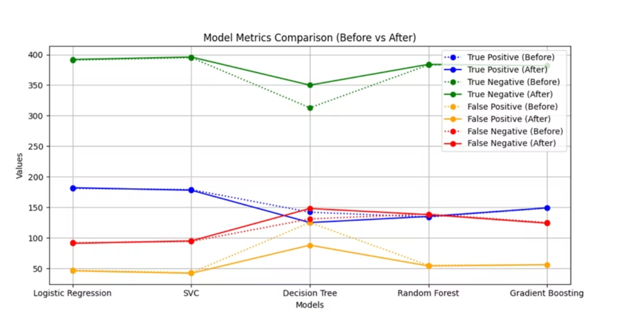
Model Metrics Comparison
Detailed comparison of model metrics. Showing True Positives (TP), True Negatives (TN), False Positives (FP), and False Negatives (FN).
The models improved the ability to correctly identify positive cases. We observed decreased false negatives and enhanced recall after GAN integration.

Slide 26
Model Metric Comparison
Comparison of model metrics. Showing True Positives (TP), True Negatives (TN), False Positives (FP), and False Negatives (FN).
Model
Accuracy Before
Accuracy After
TP Before
TN Before
FP Before
FN Before
TP After
TN After
FP After
FN After
Logistic Regression
80.45
80.73
181
391
47
92
182
395
43
91
SVC
80.73
80.73
179
395
43
94
178
392
46
95
Decision Tree
63.99
66.81
142
313
125
131
148
350
88
125
Random Forest
72.71
73.00
134
383
55
139
135
384
54
138
Gradient Boosting
74.68
74.68
149
382
56
125
149
382
56
124

Slide 27
Result Discussion
1
Reduced Bias
2
Model Benefits
GANs effectively reduced bias toward the majority class. This resulted in a more equitable model performance.
SVM and LR models benefited the most from GAN integration. They demonstrated significant performance improvements.
3
Improved Generalization
4
Clinical Usability
Decision Tree models showed better generalization capabilities. This is crucial for real-world clinical applicability.
Models are now more clinically usable and reliable. They are more useful in diagnostic settings.

Slide 28
Ethical & Real-World Implications
1
Fairness Testing
2
Bias Detection
Implement rigorous fairness testing for synthetic data. This ensures unbiased model outputs.
Employ SHAP values for detecting bias in the model. It enhances model transparency.
3
Clinical Applicability
4
Data Privacy
Design a low-risk screening tool for broad clinical use. Improves early heart disease detection.
Guarantee data privacy and generalization. The model respects patient confidentiality.

Slide 29

Future Scope
Future work focuses on real-world data integration. This includes ECG and scan data from hospitals.
We plan to evaluate deep learning models. Models such as TabNet and CNN will be included.
Deployment options include API or a mobile health app. This will enhance accessibility.
Cross-validation with other hospitals will improve results. This will create more robust models.

Slide 30
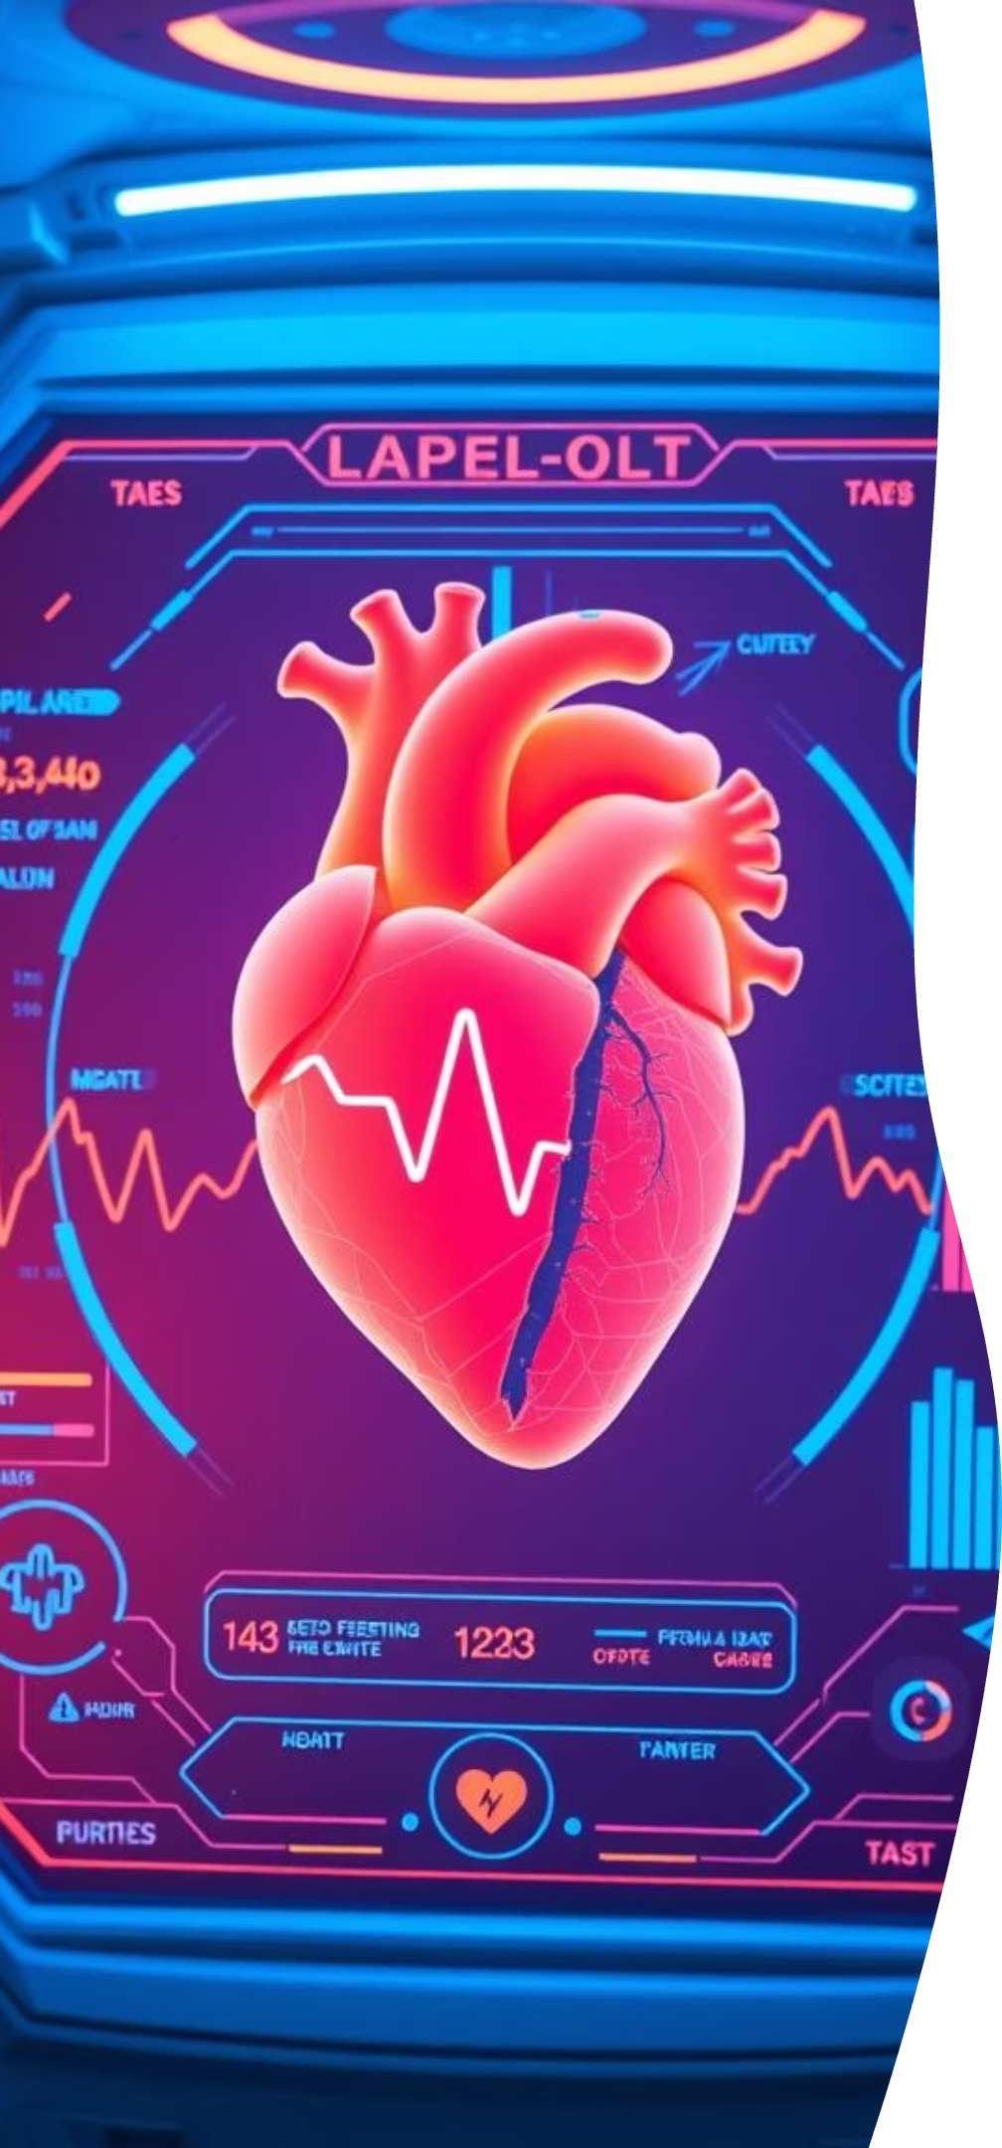



Conclusion
Enhanced Performance
Improved Recall
Model Suitability
Recall improved across models. This reduces missed diagnoses.
SVM and LR models are particularly suitable for clinical deployment.
The ML + GAN hybrid approach significantly boosts predictive performance.

Slide 31

Thank You / Q&A
Gratitude
Acknowledgements
Thank you for your attention. We appreciate your time and interest in our work.
We thank our mentors for guidance. We also acknowledge all study participants.
We would be happy to address any questions you may have at this time. Your insights are valuable.

